Slide 1
Movie Genre Popularity During Economic Downturns
Data Analytics Capstone: Hazel Choe

Slide 2
Research Objective
Do certain movie genres thrive during U.S. economic downturn, and what does this reveal about consumer demand for entertainment under stress?

Slide 3
Why it matters?
Movies = Cultural Mirror
Recessions test entertainment choices

Slide 4
Data Analysis
Data Cleaning
Recession vs. Normal Average
Correlation Analysis
Time Series Trends with Recessions
Cleaned data (currency, % into numbers)
Calculated average market share during recession years vs. normal years
Compared genre shares with unemployment & GDP growth to see which genres link to downturns
Tracked genre shares year by year, shading recession periods (2001, 2007-09, 2020)

Slide 5
U.S. Recessions (2000-2025)
Dot-com Recessions
Year: 2001
Great Recessions
Year: 2007~2009
Covid-19 Recession
Year: 2020

Slide 6
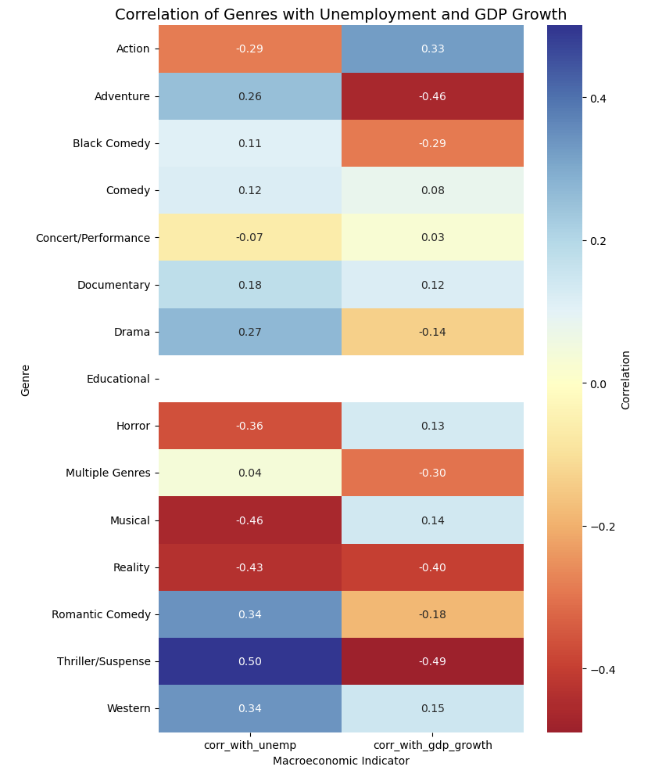
Recession-resilient genres:
Adventure & Thriller/Suspense thrive in downturns
Not recession-resilient:
Comedy shows a mild short-term bump, but overall trend is declining
Recession-sensitive genres:
Action, Horror, Reality, Musicals decline when the economy weakens
Correlations per genre (with unemployment and GDP growth)

Slide 7
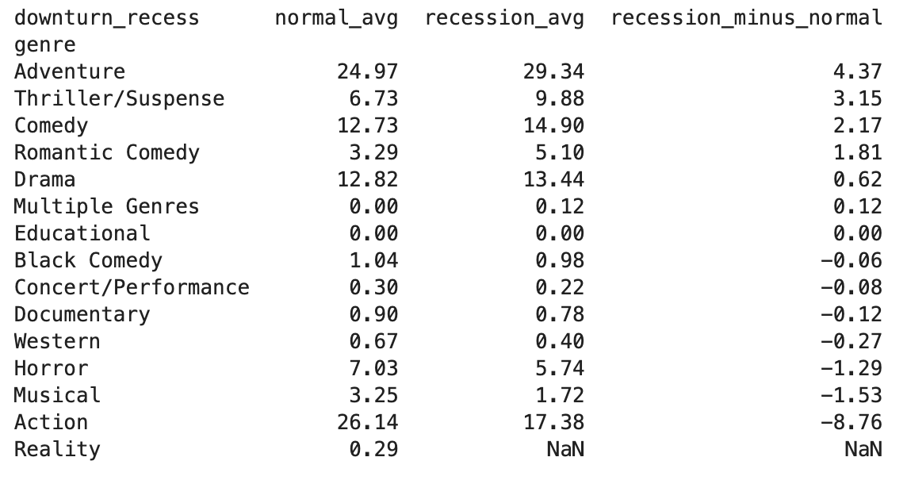
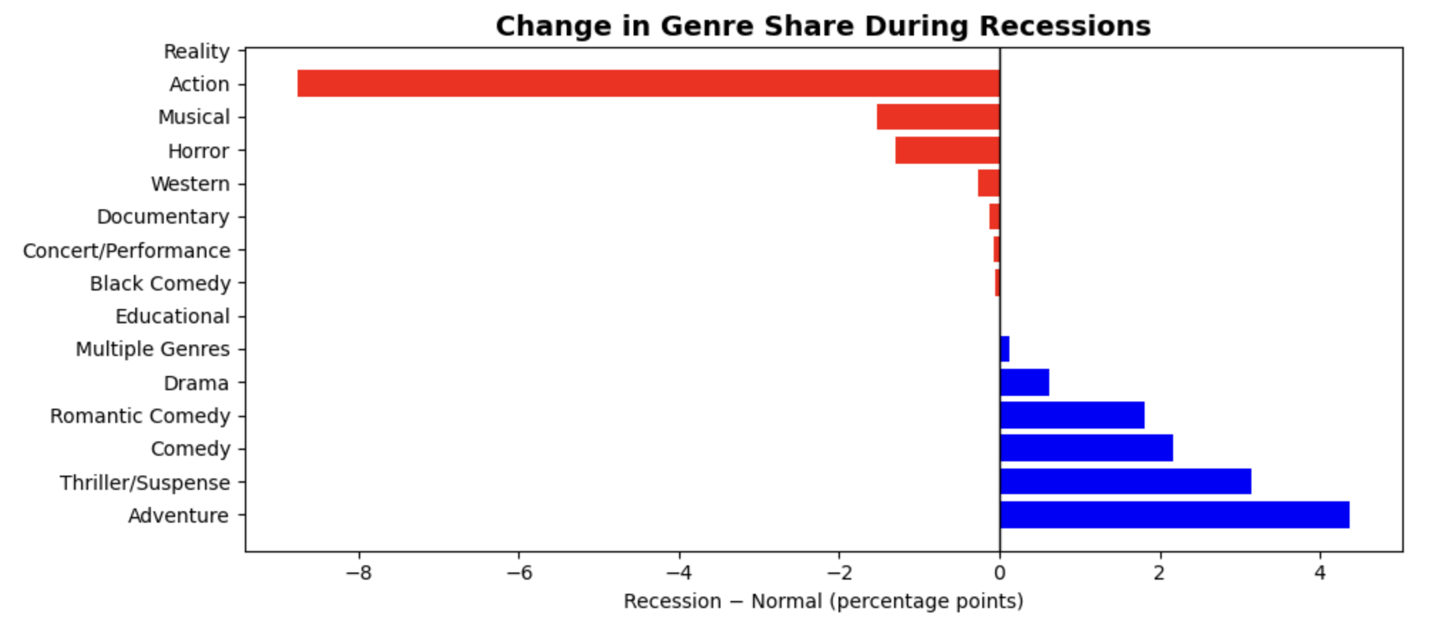
Recession-resilient genres:
Adventure (+4.3 percentage points)
Thriller (+3.1 percentage points)
Comedy (+2.2 percentage points)
Temporary bump, not sustained resilience
Drama (+1.8 percentage points)
Recession sensitive:
Action (-8.8 percentage points)
Reality, Horror, Musicals decline
Overall:
Escapist & emotional genres rise
Intense & artificial genres fall
Recession vs. Normal Average

Slide 8
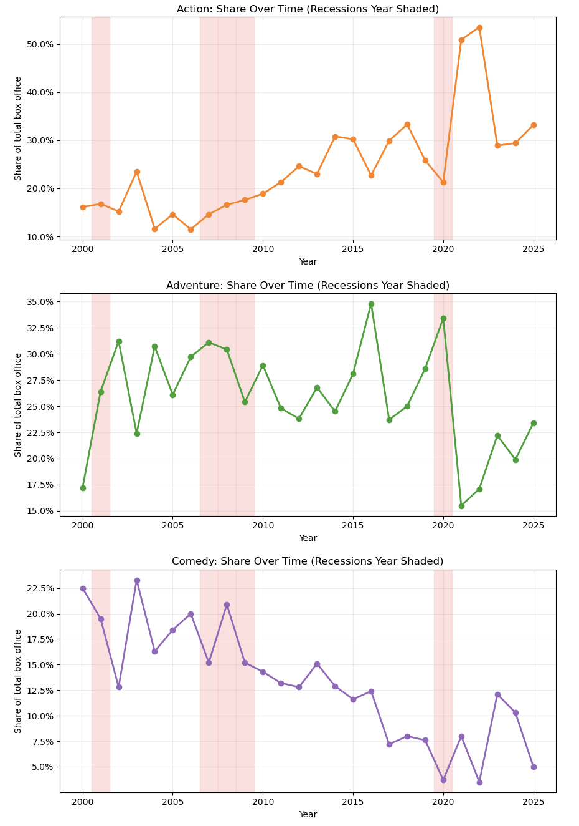
Action:
Strong long-run growth
Only 2020 recession caused a steep drop before rebound
Adventure:
Generally stable, resilient in 2008~2009 but collapsed in 2020
Comedy:
Long-term decline, not recession-resilient (keep falling even in downturns)
Time Series Plot with Recessions

Slide 9
Implications for Stakeholders
Studio & Producers
Prioritize Adventure / Thriller projects in downturns
Streaming Platforms
Promote escapist content to retain subscribers
Investors
Genre mix signal resilience in box office returns
Society
Films serve as coping mechanisms during hard times

Slide 10
Ethical, Legal, and Societal Implications
Ethical
Should studios exploit stress demand
Legal
Web-Scraping = fair use?
Societal
Escapism = coping vs. avoidance

Slide 11
Top 5 Movies in Each Recession Year
Dot-com Recessions
Harry Potter and the Sorcerer’s Stone
The Lord of the Rings
Shrek
Monsters,Inc
Rush Hour 2
Great Recessions
The Dark Knight
Iron Man
Indiana Jones and the Kingdom of the Crystal Skull
Kung Fu Panda
Twlight
Covid-19 Recession
Bad Boys for Life
1917
Sonic the Hedgehog
Jumanji: The Next Level
Star Wars: The Rise of SKywalker

Slide 12
Conclusion
Research Question
Do certain movie genres thrive during downturns?
Answer: Yes
Adventure, Thriller, Comedy, Drama rise; Action, Horror, Reality, Musicals fall.
Insight
Under stress, audiences prefer escapism and comfort over intensity

Slide 13
Thank You

